Slide 1
Review:
SketchPlan: Diffusion Based Drone Planning From Human Sketches
Varin Gupta

Slide 2
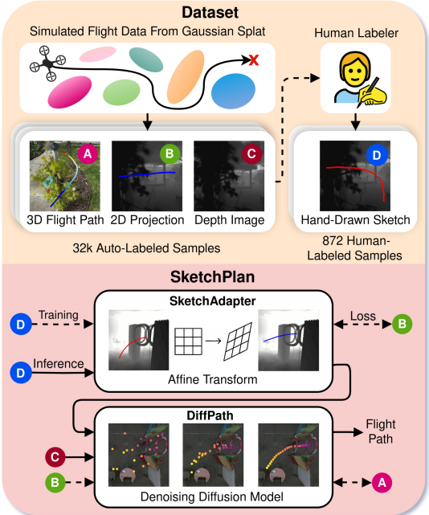
Background
Difficult to efficiently give drones instructions
Can either Teleop or give Vague Commands
Drawings help in a lot of things, but how can we translate that to an egocentric UAV?
THE IDEA
Have operators draw a 2D path on a depth image → Convert it into a 3D flight path

Slide 3
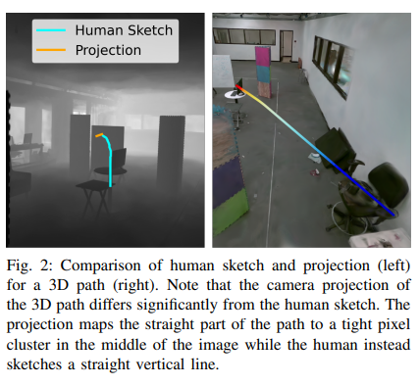
Two-Part System
SketchAdapter
Translates the human sketches to a clean 2D projection of the 3D path
DiffPath
Uses the 2D projection and depth image to generate the 3D Flight Path as a series of waypoints

Slide 4
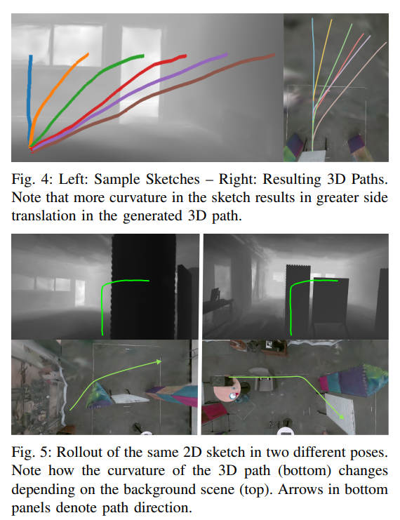
Dataset
Flight Paths were generated in 3D Gaussian Splatting Environments
2D projections were derived from the flight paths
Out of ~32000 paths, only 872 were actually hand drawn sketches
Collision filters used to see if drone safely completed the path

Slide 5
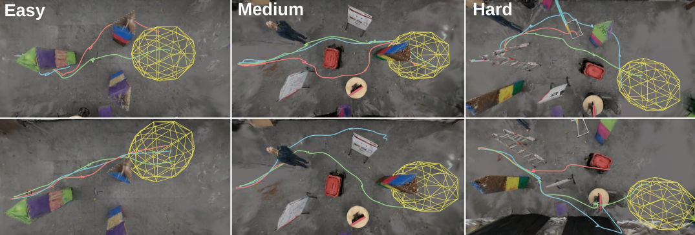
Results
Zero-shot transfer → no retraining needed for real life.
Tested in three environments: Easy, Medium, Hard.
Results:
100% success in low/medium clutter.
40% success in high-clutter (still better than other versions by 20–60%).
Drone could follow multiple sketches sequentially to reach goals.

